Slide 1



AWS Foundation
Introduction to IAM & CloudWatch
Copyright IntelliPaat, All rights reserved

Slide 2
Agenda
1
Pre-IAM
8
IAM Policies
15
Pre-CloudWatch
22
Demo 2: Alarm
Why Access Management?
9
Demo 2: IAM Policies
16
Introduction to CloudWatch
23
2
CloudWatch Logs
Amazon Resource Name (ARN)
10
IAM Permissions
17
24
3
Metrics & Namespaces
Demo 3: Logs
4
IAM Features
11
IAM Roles
18
Architecture
25
Pricing
5
Multi-Factor Authentication (MFA)
12
Demo 3: Roles
19
Dashboard
26
Design Patterns
6
Demo 1: IAM Users & Groups
13
Identity Federation
20
Demo 1: Metrics & Namespaces
27
Quiz
7
JSON
14
Pricing
21
CloudWatch Alarms

Slide 3
Introduction to IAM

Slide 4


Introduction to IAM
AWS Identity and Access Management (IAM) is a web service that helps you securely control access to AWS resources.
You use IAM to control who is authenticated (signed in) and authorized (has permissions) to use resources.

Slide 5





Why Access Management?
Server
Receives all the access to the server
Only Web development dashboard
Only Data analytics dashboard
Admin
Web Developer
Data Scientist

Slide 6
Pre-IAM

Slide 7

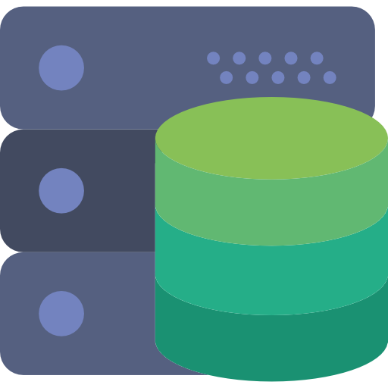




Pre-IAM
Users and Groups
User 1
NoAccess
Group
Authentication and Authorization
Users – A person using AWS services
Groups – Group of Users
Permissions – Read, Write or Execute
Access
User 2
NoAccess

Slide 8
Amazon Resource Name

Slide 9
Amazon Resource Name
Amazon Resource Names uniquely identify AWS resources. Every resource in AWS is provided with an ARN.
ARN Format:
arn:partition:service:region:account-id:resource
arn:partition:service:region:account-id:resourcetype/resource
arn:partition:service:region:account-id:resourcetype:resource

Slide 10

Amazon Resource Name
EC2
EBS
Instance > arn:aws:ec2:region:account-id:instance/instance-id
AMI > arn:aws:ec2:region::image/image-id
Key-pair > arn:aws:ec2:region:account-id:key-pair/key-pair-name
N/W Interface > arn:aws:ec2:region:account-id:network-interface/eni-id
Volume > arn:aws:ec2:region:account-id:volume/volume-id
Snapshot > arn:aws:ec2:region:account-id:snapshot/snapshot-id

Slide 11
Amazon Resource Name
VPC > arn:aws:ec2:region:account-id:vpc/vpc-id
Route Table > arn:aws:ec2:region:account-id:route-table/route-table-id
SG > arn:aws:ec2:region:account-id:security-group/security-group-id
NACL > arn:aws:ec2:region:account-id:network-acl/nacl-id
IGW > arn:aws:ec2:region:account-id:internet-gateway/igw-id
Subnet > arn:aws:ec2:region:account-id:subnet/subnet-id
Peering > arn:aws:ec2:region:account-id:vpc-peering-connection/peering-id

Slide 12






IAM Hierarchy
Account (ROOT)
user1
group1
group2
user2
guser1
Edward
guser2
Anil
guser3

Slide 13
IAM Features

Slide 14

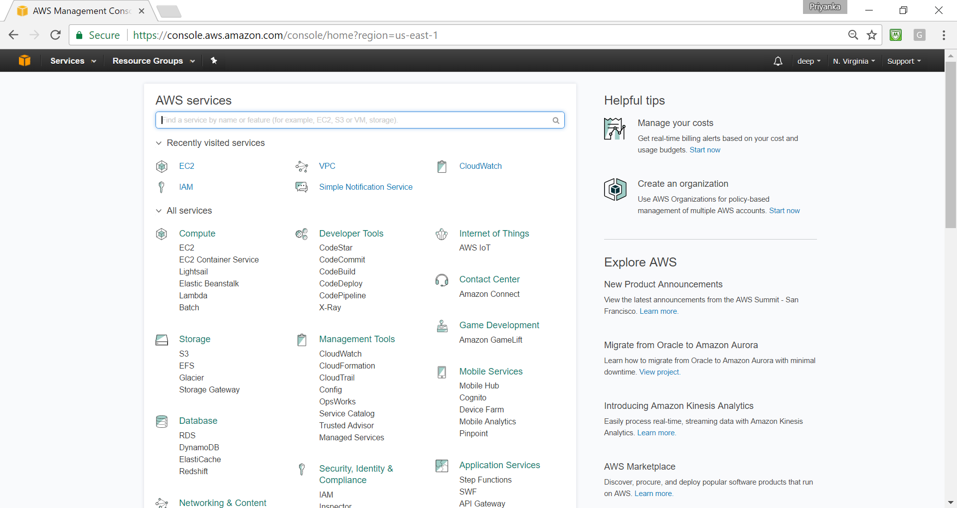

IAM Features
IAM Users
Represents an entity that is created in AWS, can be a person or service.
No permissions by default. Nothing is allowed.
Access requirement
Programmatic Access: User needs to make API calls from programs or uses CLI to access AWS resources.
Management Console Access: User needs to access AWS resources from management console.
EC2
S3
DynamoDB

Slide 15



IAM Features
IAM Users
EC2
Access Keys
Max 2 ACTIVE access keys at a time.
When disabled access keys cannot be used to make CLI or API calls.
CLI
S3
DynamoDB
Access Key
Access Key ID
Secret Access Key

Slide 16



IAM Features
IAM Groups
Groups are collection of IAM users.
Admin
Developer
Operations
admin1
dev1
ops1
admin2
dev2
ops2
dev3
ops3
admin3
dev4
dev5

Slide 17
Multi-Factor Authentication

Slide 18

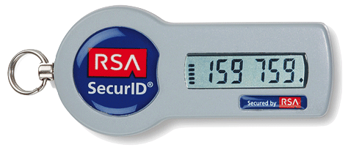
IAM Features
Security Token Based
Multi-Factor Authentication
SMS Based

Slide 19
Demo 1: IAM Users & Groups

Slide 20
Demo 1: IAM Users & Groups
Create 2 users using IAM console – admin1, user1.
Use “admin1” and “user1” to sign in to the console.
Login to the management console using both the users.
Create 2 groups – awsfoundation, consolegroup.
Add “admin1” to group awsfoundation and “user1” to consolegroup.
Create access keys for both the users.
Deactivate the access keys.
Rotate access keys (only using CLI).
Find unused passwords and access keys.
Check credential report.
Delete all the users and groups.
Enable MFA for admin1 user.

Slide 21
The “ROOT” User
The “ROOT” User
Root user should not be used at all.
MFA should be enabled for ROOT user as well.
ROOT user can also be used for programmatic access.
Access ID and Secret Access key can be created for ROOT user as well.

Slide 22
JSON

Slide 23
JSON
{
“EmpID” : 12345 ,
“EmpName” : “xyz” ,
}
“EmpID”
“Address”
“Address” : {
“Building” : “Bldg-1” ,
“Street” : ”40/1 Blvd” ,
“ZipCode” : 654321
} ,
“Address.Street”
Introduction to JSON – Java Script Object Notation
“Skills[1]”
“Skills” : [ “AWS” , “Java” , “Oracle” ] ,
“cars[0].name”
“cars” : [
{ “name” : “Toyota” , “models” : [ “Prius” , “Camry” , “Corolla”] } ,
{ “name” : “Honda” , “models” : [ “Accord” , “Civic” ] } ,
{ “name” : “Jeep” }
]
“cars[1].models[0]”

Slide 24
JSON
Previous Record
{
“EmpID” : 12345 ,
“EmpName” : “xyz” ,
“Address” : {
“Building” : “Bldg-1” ,
“Street” : “40/1 Blvd” ,
“ZipCode” : 654321 ,
} ,
“Skills” : [ “AWS” , “Java” , “Oracle” ] ,
“cars” : [
{ “name” : “Toyota” , “models” : [ “Prius” , “Camry” , “Corolla”] } ,
{ “name” : “Honda” , “models” : [ “Accord” , “Civic” ] } ,
{ “name” : “Jeep” }
]
}

Slide 25
IAM Policies

Slide 26
IAM Policies
Policies are JSON documents which mention what an user or group can do on AWS resources. It defines the Authorization paradigm for AWS resources.
Contains 3 components at the least (EAR):
Policies can be attached to Users or Groups.
EFFECT: Whether ACTIONs are ALLOWED/DENIED on RESOURCEs.
ACTIONS: What actions are allowed or denied. e.g. create EC2 instance, delete S3 buckets, create Security Groups etc. all are different type of ACTIONS.
RESOURCES: AWS resources like EC2 instances, ELB, S3 buckets or objects etc. Denoted by ARN.

Slide 27
IAM Policies
Resource based policies: when policies are attached to resources.
PRINCIPAL: An entity that can take action on an AWS Resource.
Group
S3
Effect, Action,
Resource : “S3”
Effect, Action,
Resource : “S3”
Principal : “user-1”

Slide 28
IAM Policies
Policy with a single statement
{
"Version" : "2012-10-17" ,
"Statement " : [
{ "Effect" : "Allow" ,
"Action " : "s3:ListBucket" ,
"Resource" : "arn:aws:s3:::aws-foundation-bucket"
}
]
}
Version →
2012-10-17, current version.
2008-10-17, previous version.

Slide 29
IAM Policies
IAM Policies
“Statement” : [ { } , { } , { } ]
Sid : Statement ID.
Effect : Allow/Deny.
Principal : ARN of AWS user, account or service which is allowed or denied access to a AWS resource.
Action : Specific action that is allowed or denied on an AWS resource.
Resource : ARN of the AWS resource.
Condition : Condition when a policy is in effect.
AWS Managed Policies.
Customer Managed Policies.
Inline Policies

Slide 30
IAM Policies
Examples
Allow users to access a specific S3 bucket (aws-foundation)
{
"Version": "2012-10-17",
"Statement": [ // Statement STARTs here
{
"Effect": "Allow",
"Action": "s3:ListAllMyBuckets",
"Resource": "arn:aws:s3:::*"
} ,
{
"Effect": "Allow",
"Action": [
"s3:ListBucket",
"s3:GetBucketLocation"
],
"Resource": "arn:aws:s3:::aws-foundation"
},
{
"Effect": "Allow",
"Action": [
"s3:PutObject",
"s3:GetObject",
"s3:DeleteObject"
] ,
"Resource": "arn:aws:s3:::aws- foundation/*"
}
] // Statement ENDs here
}

Slide 31
Demo 2: IAM Policies

Slide 32

Demo 2: IAM Policies
Create a policy with the following
Allow to create EC2 instances.
Allow to list all EC2 instances.
Deny access to terminate EC2 instances.
Allow access to create Classic Load Balancer and launch instances under it.
Create policy with the following
Allow access to create VPC, Security Groups, Subnets and Network ACLs.
Allow access to list all objects in a specific S3 bucket.
Resource based policy using S3

Slide 33
Demo 2: IAM Policies
Select AMI – Need to see the AMIs
Select VPC – Need to see all the available VPCs
Select SG – Need to see all the available SGs
Select Key-Pair
Launch the instance

Slide 34
IAM Policy Evaluation Logic
Policy Evaluation Logic
DENY all requests
Check all associated policies
{ }
{ }
Is there an explicit DENY
YES
{ }
NO
DENY the request
Is there an ALLOW
ALLOW the request
NO
YES

Slide 35
IAM Permissions

Slide 36
IAM Permissions
IAM Permissions
Permissions are given by attaching policies to users or groups.
No permission by default for all IAM users.
AWS account “root” credential.
Use the policies defined earlier to provide access to users and groups.

Slide 37
IAM Permissions
IAM Permissions
Permission Policy
Role
IAM user in the same account
Trust Policy
IAM user in different account
{
“Effect” : “Allow”,
“Action” : “sts:AssumeRole”,
“Principal” : “ec2.amazonaws.com”
}
Another AWS service
JSON Permission
An external user

Slide 38
IAM Roles

Slide 39
IAM Roles
IAM Roles
Role is similar to an user/group which has permissions/policies attached to it.
Roles are temporary access given to anyone who needs to perform the specific task mentioned in the Role.
Permissions attached to the users are taken away till the time role is getting used.
Cannot access EC2
Cannot access RDS
Role: Can access EC2
Role: Can access RDS

Slide 40
IAM Roles
Cross-Account Roles
Roles and Permissions between Different Accounts and Users.
Account-1
Role
Account-2
user-1
EC2 Instances

Slide 41
Demo 3: Roles

Slide 42
Demo 3: Roles
Create 2 users – s3-user and ec2-user.
S3-user should not have any EC2 access.
ec2-user should have all access on ec2 instances.
Create 2 roles – s3-role & ec2-role.
ec2-role should have access to launch EC2 instances and list them.
s3-role should have access to the S3 buckets.
Make s3-user to assume ec2-role and ec2-user to assume s3-role.

Slide 43

IAM Roles
Cross-Account Roles
Instance Profile
EC2
Program
S3
DynamoDB
Role

Slide 44
IAM Roles
Cross-Account Roles
Identity Federation: AWS resources can be accessed by third party Identity Providers (IdP)
Web: Facebook, Google, Amazon or any OIDC
SAML2.0: LDAP or Microsoft AD
Steps (Web Identity Federation)
Sign up as developer in Facebook or Google or Amazon account.
Create an Identity Provider in IAM.
Create Role with Trust and Permission Policy
In Trust Policy Principal should be the Web IdP
Cognito can be used as Identity Broker.
“Principal” : { “Federated” : “www.amazon.com” }
“Principal” : { “Federated” : “graph.facebook.com” }
“Principal” : { “Federated” : “accounts.google.com” }
“Action” : “sts:AssumeRoleWithWebIdentity”

Slide 45
Identity Federations

Slide 46

IAM Federations
Web Identify Federation
How does it work?
Device
Role ARN + Auth Token
AssumeRoleWithWebIdentity
STS
Temp Security Credentials
Auth
Token
EC2
Authenticate
Amazon
Google
Facebook
S3
DynamoDB

Slide 47
IAM Federations
SAML Identify Federation
Steps (SAML Federation)
Register AWS with Corporate IdP (LDAP).
That will generate a Metadata XML.
Create a SAML identity provider with the SAML metadata.
Create Roles.
These roles should be mapped with Organization’s assertions.
“Principal” : { “AWS” : “ARN of the SAML provider” }
“Action” : “sts:AssumeRoleWithSAML”

Slide 48

IAM Federations
SAML Identify Federation
How does it work?
Role ARN + SAML provider ARN
AssumeRoleWithSAML
STS
Application
Temp Security Credentials
SAML Assertion
EC2
Authenticate
S3
LDAP Identity Store
DynamoDB

Slide 49

Security Token Service
Temporary Security Credentials & STS
STS (Security Token Service) can be used to get temporary security credentials.
Temporary Access Key ID, Secret Access Key and Security Token
STS Calls.
“AssumeRole”: ARN of the Role, Duration (15 mins to 1 hour (Default) )
“AssumeRoleWithWebIdentity”: ARN of the Role, Auth Token, Duration (15 mins to 1 hour (Default))
“AssumeRoleWithSAML” : ARN of the Role, ARN of the SAML provider created in IAM, SAML assertion, Duration (15 min to 1 hour (Default)
“GetFederationToken”
“GetSessionToken”
STS Call
Application
Or
User
Security Token Service
Temp Creds

Slide 50
Pricing

Slide 51
Pricing
Entirely Free!!

Slide 52
Summary
Authorization & Authentication.
Amazon Resource Name (ARN), IAM Hierarchy.
IAM Users, Groups and Roles.
Multi-Factor Authentication.
Policy Evaluation.
IAM Roles
Roles in the same account
Cross-account Roles
Instance Profile
Identity Federation – Web (OIDC) and SAML.

Slide 53
Pre-CloudWatch

Slide 54

Pre-CloudWatch
Monitoring
Before CloudWatch, Monitoring was taking place by collecting related data and analyzing manually.
???

Slide 55
Introduction to CloudWatch

Slide 56








Introduction to CloudWatch
CloudWatch Monitoring
Monitors all AWS resources provisioned and deployed.
Sends notifications if anything goes wrong.
Following services are used in conjunction with CloudWatch:

Slide 57
Dimensions and Statistics
Dimensions and Statistics
Dimensions
Statistics: Data aggregations over a period of time.
Auto Scaling
Metrics
Standalone
EC2
Metrics
Load Balancer
Metrics

Slide 58
CloudWatch Metrics and Namespaces

Slide 59
CloudWatch Metrics and Namespaces
Metric and Namespaces
Metrics are fundamental to CloudWatch monitoring.
Individual data points which are monitored, all actions are based on metrics. e.g. CPU Utilization percentage.
All AWS services send metrics to CloudWatch by default.
cpu
cpu
EC2
disk
EBS
disk
n/w
n/w
cpu
cpu
ELB
disk
Route53
disk
n/w
n/w

Slide 60



CloudWatch Metrics and Namespaces
Resource Metrics – EC2
NetworkIn (Bytes)
CPU Utilization
NetworkOut (Bytes)
Network Interface
NetworkPacketsIn (Count)
Attached Disks
NetworkPacketsOut (Count)
DiskReadOps (Count)
DiskReadBytes (Bytes)
DiskWriteOps (Count)
DiskWriteBytes (Bytes)
Min, Max, Avg

Slide 61
CloudWatch Metrics and Namespaces
Resource Metrics – EC2
AutoScalingGroupName
CPU Utilization
Network Interface
InstanceId
Attached Disks
ImageId
CPU Credit Metrics
Instancetype
CPUCreditUsage (Count)
CPUCreditBalance (Count)

Slide 62
CloudWatch Metrics and Namespaces
Resource Metrics – EBS
Metrics | Unit | Statistics
VolumeReadBytes | Bytes | Sum, Avg, Count
VolumeWriteBytes | Bytes | Sum, Avg, Count
VolumeReadOps | Count
VolumeWriteOps | Count
VolumeTotalReadTime | Seconds
VolumeTotalWriteTime | Seconds
VolumeIdleTime | Seconds
VolumeQueueLength | Count
VolumeThroughputPercentage | Percent
VolumeConsumedReadWriteOps | Count
BurstBalance | Percent

Slide 63




CloudWatch Metrics and Namespaces
Resource Metrics – S3
BytesUploaded
Min, Max, Avg, Count, Sum
BytesDownloaded
Sum
BucketName
GetRequests (Count)
Avg
PutRequests (Count)
StorageType
DeleteRequests (Count)
NumberOfObjects (Count)
HeadRequests (Count)
BucketSizeBytes (Bytes)
PostRequests (Count)
FilterId
ListRequests (Count)

Slide 64
CloudWatch Metrics and Namespaces
Resource Metrics – DynamoDB
BytesUploaded
Min, Max, Avg, Count, Sum
BytesDownloaded
Sum
BucketName
GetRequests (Count)
Avg
PutRequests (Count)
StorageType
DeleteRequests (Count)
NumberOfObjects (Count)
HeadRequests (Count)
BucketSizeBytes (Bytes)
PostRequests (Count)
FilterId
ListRequests (Count)

Slide 65
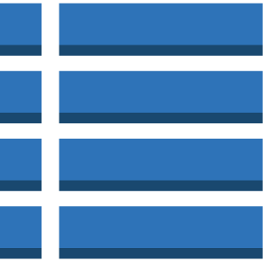



CloudWatch Metrics and Namespaces
Resource Metrics – DynamoDB
GlobalSecondaryIndexName
StreamLabel
TableName
PutItem
DeleteItem
UpdateItem
GetItem
BatchGetItem
Scan
Query
BatchWriteItem
Table
Item
Attributes
Min, Max, Avg, Count, Sum
ConsumedReadCapacityUnits
ProvisionedReadCapacityUnits
ConsumedWriteCapacityUnits
ProvisionedWriteCapacityUnits
GSI/LSI
OnlineIndexConsumedWriteCapacity
ReadThrottleEvents
OnlineIndexPercentageProgress
WriteThrottleEvents
OnlineIndexThrottleEvents
ThrottledRequests

Slide 66
CloudWatch Metrics and Namespaces
Resource Metrics – AS
GroupMinSize
GroupMaxSize
GroupDesiredCapacity
GroupInServiceInstances
GroupPendingInstances
GroupStandbyInstances
GroupTerminatingInstances
GroupTotalInstances

Slide 67
CloudWatch Architecture

Slide 68




CloudWatch Architecture
Architecture
EC2 Metrics
DynamoDB Metrics
EBS Metrics
Statistics
Console
S3 Metrics
Statistics User

Slide 69
CloudWatch Dashboard

Slide 70




CloudWatch Dashboard
Dashboards
Dashboards are pages in the console which can be used to put all the important statistics deemed important at one place.

Slide 71
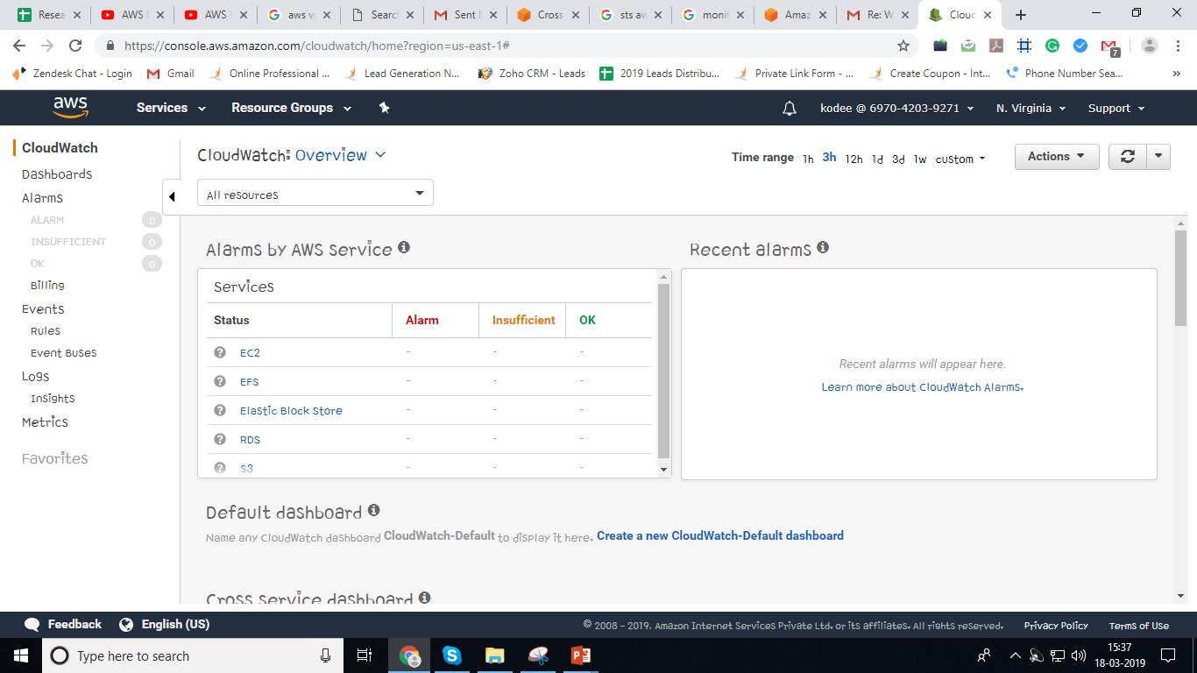
CloudWatch Dashboard

Slide 72
Demo 1: Dashboard & Metric Stats

Slide 73
Demo 1: Dashboard & Metric stats
Create a Dashboard – AWS-foundation-dashboard.
Add widgets for EC2, ELB and S3.
Graph Options.
Graphed Metrics.
Edit a widget.
Rename the graph.
View Statistics for metrics for a specific resource.

Slide 74
CloudWatch Alarm

Slide 75

CloudWatch Alarm
Alarm
Alarms watch over metrics and metrics only.
Alarms can be set to take action based on metrics data.
CPUUtilization
Action
BytesDownloaded
Action

Slide 76
CloudWatch Alarm
Alarm
Alarm States
OK – Within Threshold.
ALARM – Crossed Threshold.
INSUFFICIENT_DATA – Metric not available/ Missing data (Good, Bad, Ignore, Missing).
Alarm Threshold and Period. (Threshold of 75% for 3 consecutive times)
75%
CPU Util
Time

Slide 77
Demo 2: Alarm

Slide 78
Demo 2: Alarm
Alarm
Create an Alarm.
Alarm should monitor CPU Utilization of an EC2 instance.
Decide on the Threshold and period.
Provision all the 3 actions – SNS, Auto Scale and EC2 instance termination.
Create Billing Alarm.

Slide 79
CloudWatch Logs

Slide 80
CloudWatch Logs
Logs
CloudWatch logs are used to monitor, store and access log files from various AWS resources including EC2 etc.
How does it work:
Logs
agent
CLI plug-in which pushes data to CloudWatch Logs
Script which runs “aws logs push” command to send data to CW Logs
Cronjob which ensures that the agent daemon runs all the time

Slide 81
CloudWatch Logs
CloudWatch Log Components
Log Events: Record of some activity recorded by the application being monitored.
Log Group
Log Group
Log Stream
Log Stream
Log Event 1
Log Streams: Sequence of log events from the same source
Log Stream
Log Event 2
Log Groups: Group of Log Streams.
Log Event 3
Log Stream
Metric Filters: Customized metrics created from received log data.

Slide 82
CloudWatch Logs
Installing Logs Agent
Install and configure the agent
sudo yum install -y awslogs
/etc/awslogs/awscli.conf
/etc/awslogs/awslogs.conf
sudo service start awslogs
/var/log/awslogs.log
sudo chkconfig awslogs on

Slide 83
CloudWatch Logs
Log Config File
Config File: Contains information needed by “aws logs push” command.
General Section:
state_file
logging_config_file
Logstream Section:
log_group_name = value
log_stream_name = value
file = value
batch_count = integer
batch_size = integer

Slide 84
Demo 3: CloudWatch Logs

Slide 85
Demo 3: CloudWatch Logs
Configure log agent in an EC2 instance.
Create log group.
Use Filter patterns.
Export data to S3.

Slide 86
Pricing

Slide 87
CloudWatch Pricing (us-east-1)
Free Tier
3 dashboards up to 50 metrics per month
Basic monitoring at 5 mins interval of EC2, EBS, ELB, RDS are free.
https://aws.amazon.com/cloudwatch/pricing/
Pricing
Dashboards: $3.00 per dashboard per month
Detailed monitoring for EC2 instances
Custom Metrics
Alarms: $0.10 per alarm/month
CloudWatch Logs
CloudWatch Events

Slide 88
Design Patterns

Slide 89


Design Patterns
CloudWatch
EC2
Kinesis
EMR
S3

Slide 90



Design Patterns
CloudWatch
S3
EC2

Slide 91
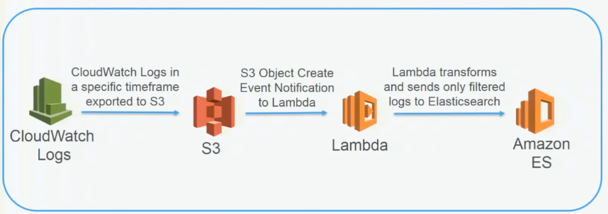
Design Patterns

Slide 92
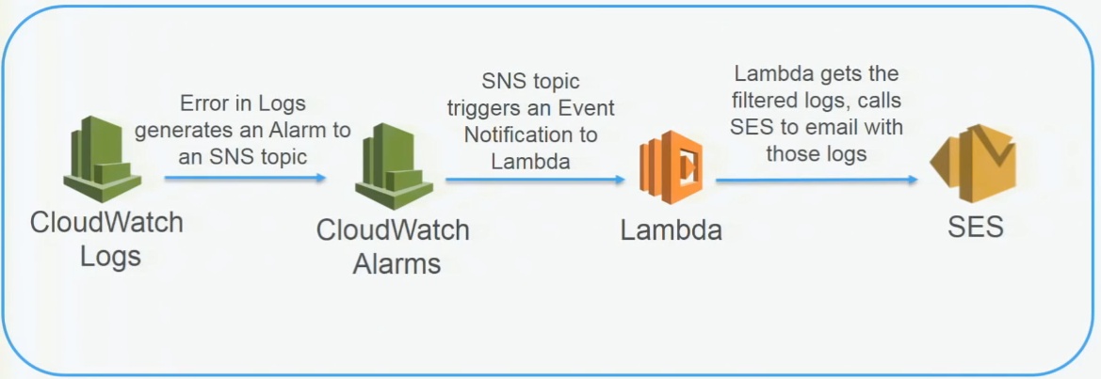
Design Patterns

Slide 93
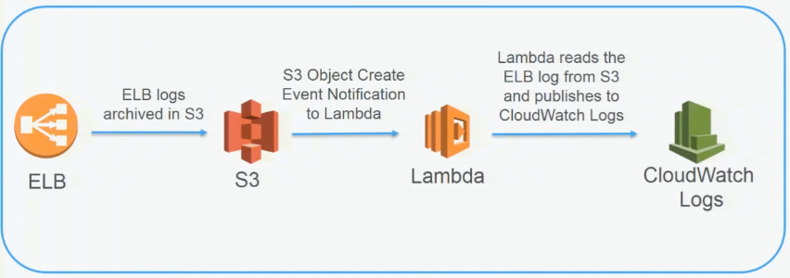
Design Patterns

Slide 94
Quiz

Slide 95
Quiz
1. When CloudWatch state is ALARM, does it mean that the metric is within the defined threshold?
A. Yes
B. No

Slide 96
Quiz
2. Is CloudWatch DisReadOps Metric used to calculate the average I/O operations per second (IOPS)
A. Yes
B. No

Slide 97
Quiz
3. Cloudwatch retains metric data points with a period of 60 seconds for 15 days
A. Yes
B. No

Slide 98

India : +91-7847955955
US : 1-800-216-8930 (TOLL FREE)
sales@intellipaat.com
24X7 Chat with our Course Advisor
Notes:
Thank you!

